Slide 1
Chapter 3
How to code and test a Windows Forms application

Slide 2
Objectives (part 1)
Applied
Given the code for a simple application, use the skills presented in this chapter to add the code and test the application.
Use indentation and blank lines to make the code easier to read.
Use comments to document the code for the entire form or for portions of the code.
Use any of the help features to get the information that you need for developing an application.

Slide 3
Objectives (part 2)
Knowledge
In the context of object-oriented programming, describe these terms: class, object, instantiation, instance, property, method, event, and member.
Describe how an application responds to events.
Describe the use of snippets and refactoring.
Distinguish between a syntax (or build) error and a runtime error.
Distinguish between testing and debugging.
Explain how a data tip can help debug a runtime error.

Slide 4
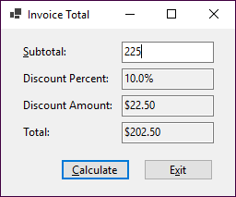
A form object and its ten control objects

Slide 5
Class and object concepts
An object is a self-contained unit like a form or control that combines code and data.
A class is the code that defines the characteristics of an object. You can think of a class as a template for an object.
An object is an instance of a class, and the process of creating an object from a class is called instantiation.
More than one object instance can be created from a single class.

Slide 6
Property, method, and event concepts
Properties define the characteristics of an object and the data associated with an object.
Methods are the operations that an object can perform.
Events are signals sent by an object to the application telling it that something has happened that can be responded to.
Properties, methods, and events can be referred to as members of an object.
If you instantiate two or more instances of the same class, all of the objects have the same properties, methods, and events. However, the values assigned to the properties can vary from one instance to another.

Slide 7
Objects and forms
When you use the Form Designer, Visual Studio automatically generates C# code that creates a new class based on the Form class. Then, when you run the project, a form object is instantiated from the new class.
When you add a control to a form, Visual Studio automatically generates C# code in the class for the form that instantiates a control object from the appropriate class and sets the control’s default properties.
When you move and size a control, Visual Studio automatically sets the properties that specify the location and size of the control.

Slide 8
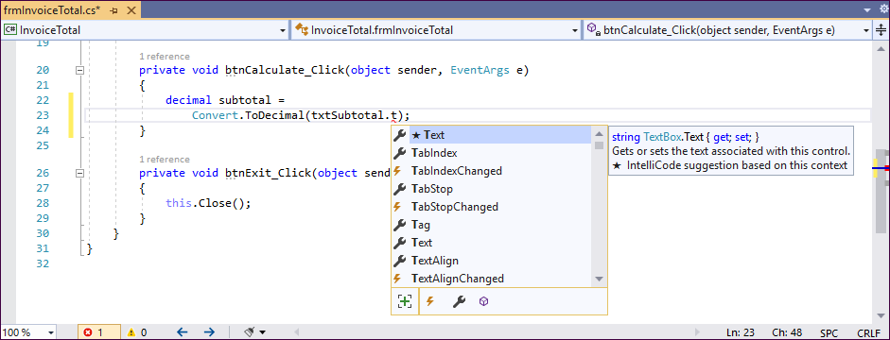
A member list in the Code Editor window

Slide 9
The syntax for referring to a member of a class or object
ClassName.MemberName
objectName.MemberName
Statements that refer to properties
txtTotal.Text = "10"; Assigns a string holding the number 10 to the Text property of the text box named txtTotal.
txtTotal.ReadOnly = true; Assigns the true value to the ReadOnly property of the text box named txtTotal so the user can’t change its contents.

Slide 10
Statements that refer to methods
txtMonthlyInvestment.Focus(); Uses the Focus() method to move the focus to the text box named txtMonthlyInvestment.
this.Close(); Uses the Close() method to close the form that contains the statement. In this example, this is a keyword that is used to refer to the current instance of the class.
Code that refers to an event
btnExit.Click Refers to the Click event of a button named btnExit.

Slide 11
How to enter member names when working in the Code Editor
To display a list of the available members for a class or an object, type the class or object name followed by a period (called a dot operator, or just dot).
Type one or more letters of the member name, and the Code Editor will select the first entry in the list that matches those letters. Or, you can scroll down the list to select the member you want.
Press the Tab or Enter key to insert the member into your code.

Slide 12
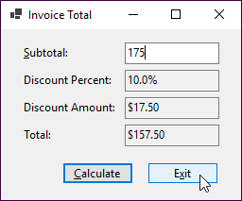
Event: The user clicks the Exit button
Wiring: The application determines what method to execute
this.btnExit.Click +=
new System.EventHandler(this.btnExit_Click);
Response: The method for the Click event of the Exit button is executed
private void btnExit_Click(object sender, System.EventArgs e)
{
this.Close();
}

Slide 13
Common control events
Event Occurs when…
Click …the user clicks the control.
DoubleClick …the user double-clicks the control.
Enter …the focus is moved to the control.
Leave …the focus is moved from the control.
Common form events
Event Occurs when…
Load …the form is loaded into memory.
Closing …the form is closing.
Closed …the form is closed.

Slide 14
How an application responds to events
Windows Forms applications work by responding to events that occur on objects.
To indicate how an application should respond to an event, you code an event handler, which is a special type of method that handles the event.
To connect the event handler to the event, Visual Studio automatically generates a statement that wires the event to the event handler. This is known as event wiring.
An event can be an action that’s initiated by the user like the Click event, or it can be an action initiated by program code like the Closed event.

Slide 15
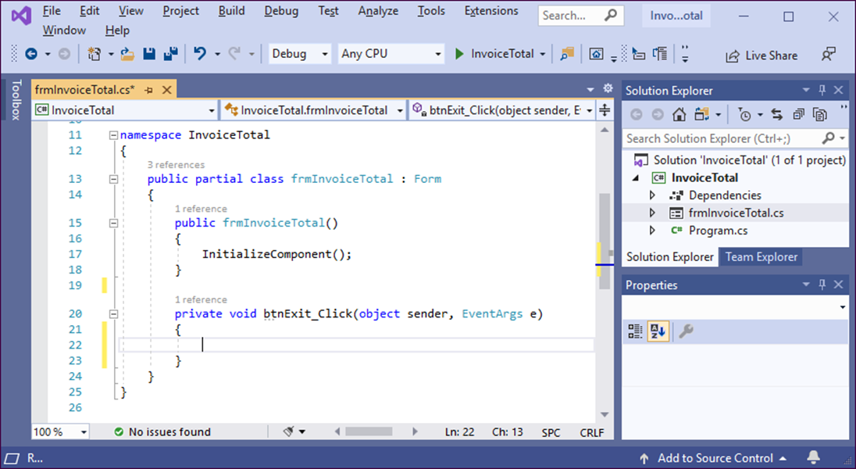
The method that handles the Click event of the Calculate button

Slide 16
How to handle the Click event of a button
In the Form Designer, double-click the button. This opens the Code Editor, generates the declaration for the method that handles the event, and places the cursor within this declaration.
Type the C# code between the opening brace ({) and the closing brace (}) of the method declaration.
When you are finished writing code, you can return to the Form Designer by clicking on its tab.
How to handle the Load event for a form
Follow the procedure above, but double-click the form itself.

Slide 17
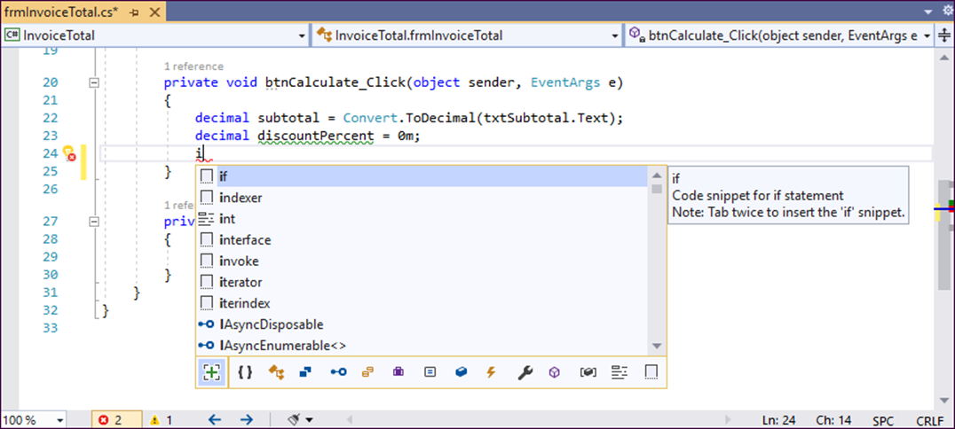
The completion list that’s displayed when you enter a letter at the beginning of a line of code

Slide 18
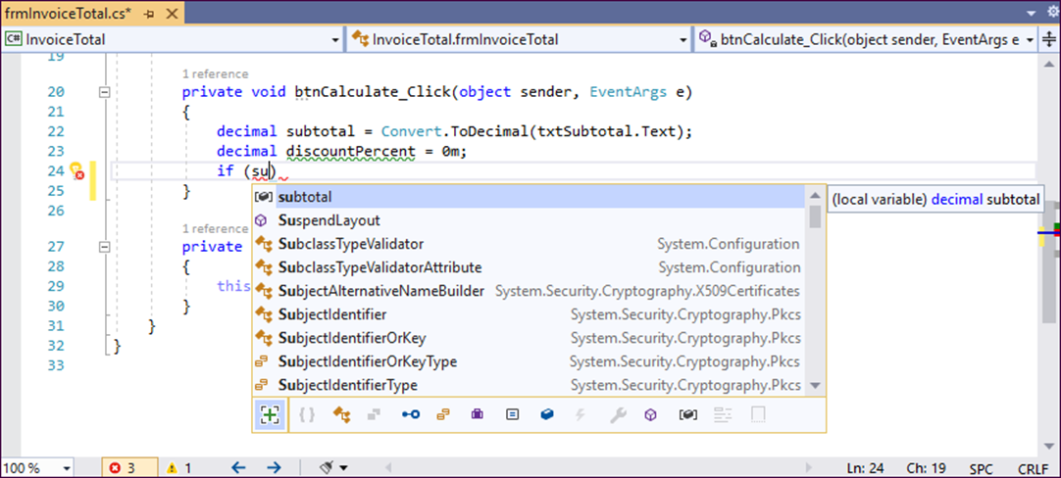
The completion list that’s displayed as you enter code within a statement

Slide 19
Event handlers for the Invoice Total form (part 1)
private void btnCalculate_Click(object sender,
EventArgs e)
{
decimal subtotal =
Convert.ToDecimal(txtSubtotal.Text);
decimal discountPercent = 0m;
if (subtotal >= 500)
{
discountPercent = .2m;
}
else if (subtotal >= 250 && subtotal < 500)
{
discountPercent = .15m;
}
else if (subtotal >= 100 && subtotal < 250)
{
discountPercent = .1m;
}

Slide 20
Event handlers for the Invoice Total form (part 2)
decimal discountAmount = subtotal * discountPercent;
decimal invoiceTotal = subtotal - discountAmount;
txtDiscountPercent.Text =
discountPercent.ToString("p1");
txtDiscountAmount.Text =
discountAmount.ToString("c");
txtTotal.Text = invoiceTotal.ToString("c");
txtSubtotal.Focus();
}
private void btnExit_Click(object sender, EventArgs e)
{
this.Close();
}

Slide 21
Coding rules
Use spaces to separate the words in each statement.
Use exact capitalization for all keywords, class names, object names, variable names, etc.
End each statement with a semicolon.
Each block of code must be enclosed in braces ({}). That includes the block of code that defines the body of a method.

Slide 22
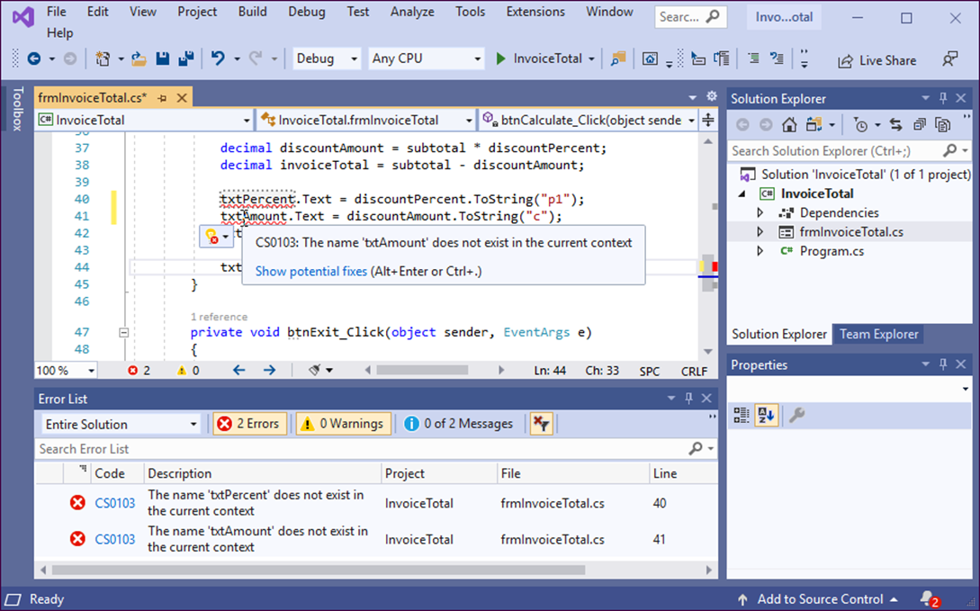
The Code Editor and Error List windows with syntax errors displayed

Slide 23
A method written in a readable style (part 1)
private void btnCalculate_Click(object sender,
EventArgs e)
{
decimal subtotal =
Convert.ToDecimal(txtSubtotal.Text);
decimal discountPercent = 0m;
if (subtotal >= 500)
{
discountPercent = .2m;
}
else if (subtotal >= 250 && subtotal < 500)
{
discountPercent = .15m;
}
else if (subtotal >= 100 && subtotal < 250)
{
discountPercent = .1m;
}

Slide 24
A method written in a readable style (part 2)
decimal discountAmount = subtotal * discountPercent;
decimal invoiceTotal = subtotal - discountAmount;
txtDiscountPercent.Text =
discountPercent.ToString("p1");
txtDiscountAmount.Text =
discountAmount.ToString("c");
txtTotal.Text = invoiceTotal.ToString("c");
txtSubtotal.Focus();
}

Slide 25
A method written in a less readable style
private void btnCalculate_Click(object sender, EventArgs e){
decimal subtotal=Convert.ToDecimal(txtSubtotal.Text);
decimal discountPercent=0m;
if (subtotal>=500) discountPercent=.2m;
else if (subtotal>=250&&subtotal<500) discountPercent=.15m;
else if (subtotal>=100&&subtotal<250) discountPercent=.1m;
decimal discountAmount=subtotal*discountPercent;
decimal invoiceTotal=subtotal-discountAmount;
txtDiscountPercent.Text=discountPercent.ToString("p1");
txtDiscountAmount.Text=discountAmount.ToString("c");
txtTotal.Text=invoiceTotal.ToString("c");txtSubtotal.Focus();}

Slide 26
Coding recommendations
Use indentation and extra spaces to align statements and blocks of code so they reflect the structure of the program.
Use spaces to separate the words, operators, and values in each statement.
Use blank lines before and after groups of related statements.
Note
As you enter code in the Code Editor, Visual Studio automatically adjusts its formatting by default.

Slide 27
A method with comments (part 1)
private void btnCalculate_Click(object sender, EventArgs e)
{
/***************************************
* this method calculates the total
* for an invoice depending on a
* discount that's based on the subtotal
****************************************/
// get the subtotal amount from the Subtotal text box
decimal subtotal = Convert.ToDecimal(txtSubtotal.Text);
// set the discountPercent variable based
// on the value of the subtotal variable
decimal discountPercent = 0m; // the m indicates
// a decimal value
if (subtotal >= 500)
{
discountPercent = .2m;
}
else if (subtotal >= 250 && subtotal < 500)
{
discountPercent = .15m;
}

Slide 28
A method with comments (part 2)
else if (subtotal >= 100 && subtotal < 250)
{
discountPercent = .1m;
}
// calculate and assign the values for the
// discountAmount and invoiceTotal variables
decimal discountAmount = subtotal * discountPercent;
decimal invoiceTotal = subtotal - discountAmount;
// format the values and display them in their text boxes
txtDiscountPercent.Text = // percent format
discountPercent.ToString("p1"); // with 1 decimal place
txtDiscountAmount.Text =
discountAmount.ToString("c"); // currency format
txtTotal.Text =
invoiceTotal.ToString("c");
// move the focus to the Subtotal text box
txtSubtotal.Focus();
}

Slide 29
How to code comments
Comments are used to help document what a program does and what the code within it does.
To code a single-line comment, type // before the comment. You can use this technique to add a comment on its own line or to add a comment at the end of a line.
To code a delimited comment, type /* at the start of the comment and */ at the end. You can also code asterisks to identify the lines in the comment, but that isn’t necessary.

Slide 30
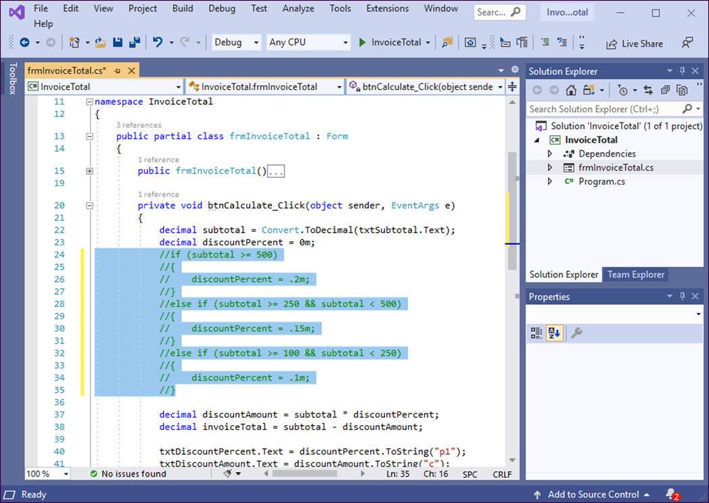
The Code Editor and the Text Editor toolbar

Slide 31
How to use the buttons of the Text Editor toolbar
To display or hide the Text Editor toolbar, right-click in the toolbar area and choose Text Editor from the shortcut menu.
To comment or uncomment several lines of code, select the lines and click the Comment Out or Uncomment button.
During testing, you can comment out lines of code so they won’t be executed. That way, you can test new statements without deleting the old statements.
To move quickly between lines of code, you can use the last four buttons on the Text Editor toolbar to set and move between bookmarks.

Slide 32
How to collapse or expand regions of code
If a region of code appears in the Code Editor with a minus sign (-) next to it, you can click the minus sign to collapse the region so just the first line is displayed.
If a region of code appears in the Code Editor with a plus sign (+) next to it, you can click the plus sign to expand the region so all of its code is displayed.

Slide 33

The completion list for the if keyword

Slide 34
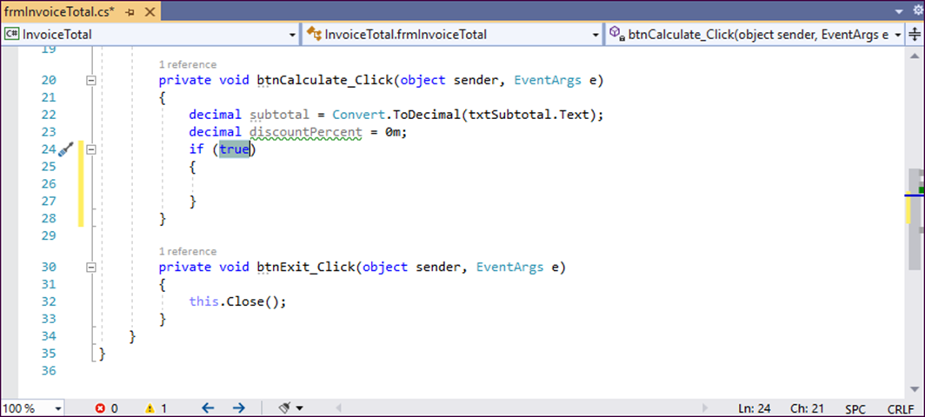
The if snippet after it has been inserted

Slide 35
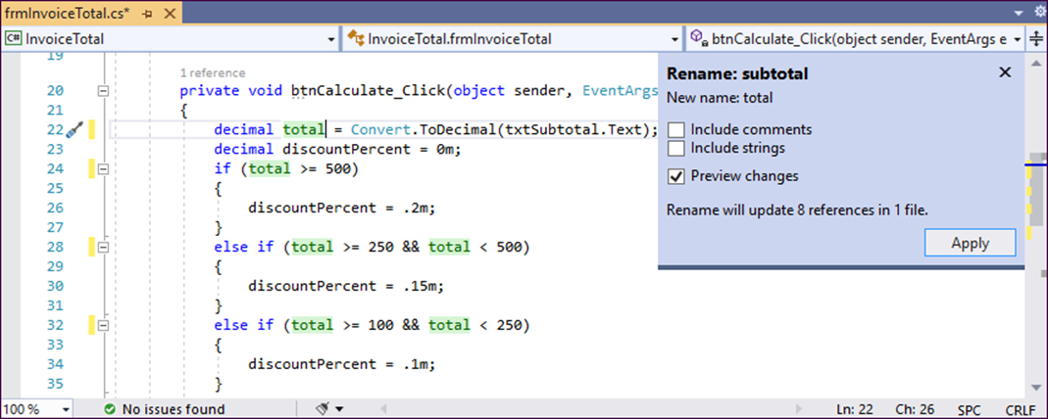
The options that are displayed when you rename a variable

Slide 36
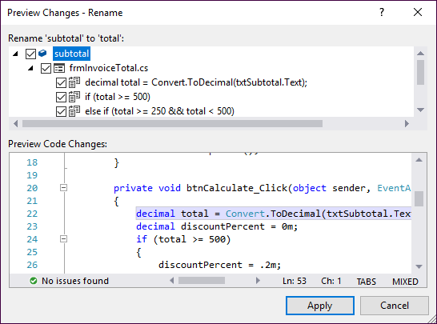
The Preview Changes - Rename dialog box

Slide 37
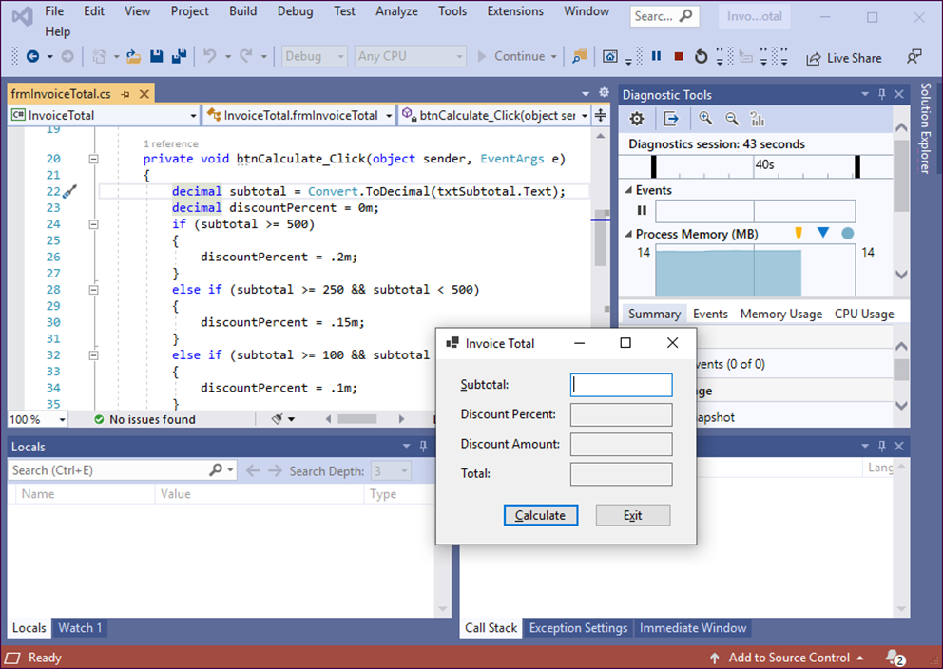
The form that’s displayed when you run the Invoice Total project

Slide 38
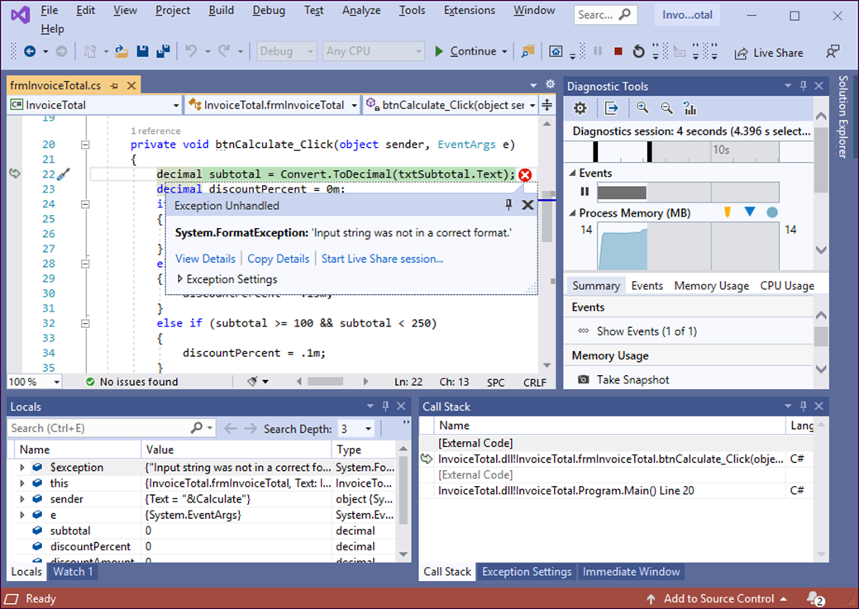
The Exception Helper that’s displayed when a runtime error occurs

Slide 39
How to test a project
Test the user interface, including the appearance of the controls, the tab order, the access keys, and the Enter and Esc keys.
Test valid input data.
Test invalid data or unexpected user actions.

Slide 40
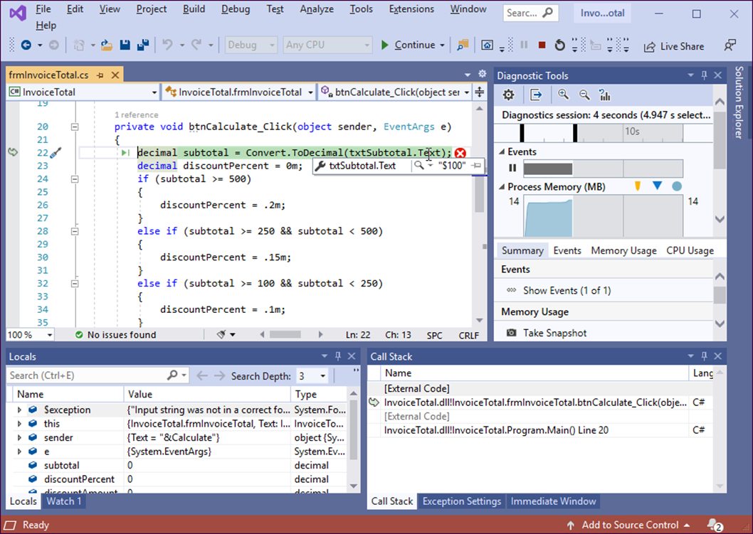
How a project looks in break mode

Slide 41
Objectives (part 1)
Applied
Given the code for a simple application, use the skills presented in this chapter to add the code and test the application.
Use indentation and blank lines to make the code easier to read.
Use comments to document the code for the entire form or for portions of the code.
Use any of the help features to get the information that you need for developing an application.

Slide 42
Objectives (part 2)
Knowledge
In the context of object-oriented programming, describe these terms: class, object, instantiation, instance, property, method, event, and member.
Describe how an application responds to events.
Describe the use of snippets and refactoring.
Distinguish between a syntax (or build) error and a runtime error.
Distinguish between testing and debugging.
Explain how a data tip can help debug a runtime error.

